Slide 1
Basic Elements of C++
Chapter 2

Slide 2
Chapter Topics
The Basics of a C++ Program
Data Types
Arithmetic Operators and Operator Precedence
Expressions
Input
Increment and Decrement Operators
Output
Preprocessor Directives
Program Style and Form
More on Assignment Statements

Slide 3
The Basics of a C++ Program
A C++ program is a collection of one or more subprograms (functions)
Function
  Collection of statements
  Statements accomplish a task
Every C++ program has a function called main

Slide 4
Example Program
#include <iostream>
using namespace std;
int main()
{
cout<<"Welcome to C++ Programming"<<endl;
return 0;
}
Welcome to C++ Programming
Program Output

Slide 5
The Basics of a C++ Program
Programming language
  a set of rules, symbols, special words
Rules
  syntax – specifies legal instructions
Symbols
  special symbols ( + - * ! … )
Word symbols
  reserved words
  (int, float, double, char …)

Slide 6
Identifiers
Rules for identifiers
  must begin with letter or the underscore _
  followed by any combination of numerals or letters
  recommend meaningful identifiers
Evaluate the following
  ElectricCharge
  23Skidoo
  snarFbLat

Slide 7
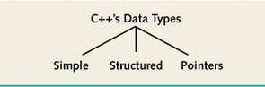
Data Types
Definition:
  a set of values
  combined with a set of operations

Slide 8
Data Types
Simple data types include
  Integers
  Floating point
  Enumeration
Integer data types include
  char
  short
  int
  long
  bool
Numerals, symbols, letters
Numbers without decimals
Values true and false only

Slide 9
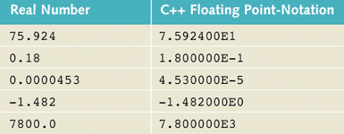
Floating-Point Types
Stored using scientific notation
  the sign of the number,
  the significant digits of the number
  the sign of the power of 10
  the power of 10

Slide 10
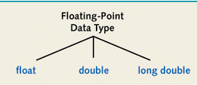
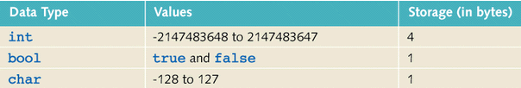
Data Types
Different floating-
point types
Note that various types will
  have different ranges of values
  require different amounts of memory

Slide 11
Data Types
The string Type
  a programmer-defined type
  requires #include <string>
A string is a sequence of characters
"Hi Mom"
"We're Number 1!"
"75607"

Slide 12
Arithmetic Operators and Operator Precedence
Common operators for calculations
+ - * / %
Precedence same as in algebraic usage
  Inside parentheses done first
  Next * / % from left to right
  Then + and - from left to right
Note operator precedence chart,
page 1035

Slide 13
Expressions
An expression includes
  constants
  variables
  function calls
  combined with operators
  3 / 2 + 5.0
  sin(x) + sqrt(y)

Slide 14
Expressions
Expressions can include
  values all of the same type
  3 + 5 * 12 – 7
  values of different (compatible) types
  1.23 * 18 / 9.5
An operation is evaluated according to the types of the operands
  if they are the same, the result is the type of the operands
  if the operands are different (int and float) then the result is float

Slide 15
Type Casting
Implicit change of type can occur
  when operands are of different type
It is possible to explicitly specify that an expression be converted to a different type
static_cast < type > (expression)
static_cast <int> (3.5 * 6.9 / x)

Slide 16
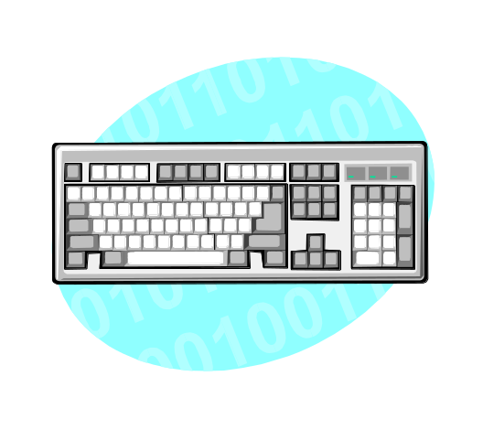
Input
Storing data in the computer's memory requires two steps
  Allocate the memory by declaring a variable
  Have the program fetch a value from the input device and place it in the allocated memory location
cin >> x
123
x

Slide 17
Allocating Memory
Variable
  A memory location whose content may change during program execution
Declaration:
  Syntax:
  type identifier;
  Example:
  double x;
  int y = 45;
Note optional initialization of the variable

Slide 18
Allocating Memory
Named Constant
  A memory location whose content cannot be changed
Declaration
  Syntax:
  const type identifier = value;
  Example
  const double PI = 3.14159;
Note required initialization of the named constant

Slide 19
Putting Data Into Variables
At initialization time
Assignment statement
  Syntax:
  variable = expression;
  Example
  x = 1.234;
  volume = sqr (base) * height;
Input (read) statement
  Syntax:
  cin >> variable ;
  Example
  cin >> height;
Program Example

Slide 20
Increment and Decrement Operators
Pre-increment ++x;
equivalent to x = x + 1;
  Pre-decrement --x;
  Changes the value before execution of a statement y = ++x;
Post-increment intVal++;
  Post-decrement intVal--;
  Changes the value after execution of the statement y = x++;

Slide 21
Output
Values sent to an output device
  Usually the screen
  Can also be a file or some device
Syntax for screen output:
cout << expression << …
Example
cout << "The total is "<< sum << endl;
Sample Program
Manipulator for carriage return
Output command
Insertion operator
Values to be printed

Slide 22
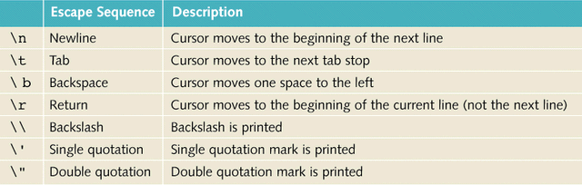
Output
Escape sequences also used to manipulate output
cout << "The total is\t "<< sum << endl;

Slide 23
Preprocessor Directives
Commands supplied to the preprocessor
  Runs before the compiler
  Modifies the text of the source code before the compiler starts
Syntax
  start with # symbol
  #include <headerFileName>
Example #include <iostream>

Slide 24
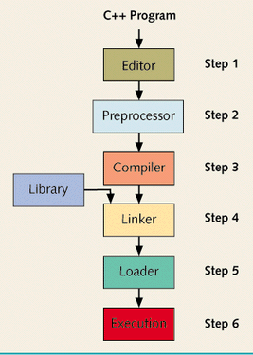
Preprocessor Directives
Note the preprocessor
step in the sequence

Slide 25
Namespace
The #include <iostream> command is where cin and cout are declared
They are declared within a namespace called std
When we specify
using namespace std;
  Then we need not preface the cin and cout commands with std::cin and std::cout

Slide 26
Program Style and Form
Every program must contain a function called main
int main (void)
{ … }
The int specifies that it returns an integer value
The void specifies there will be no arguments
Also can say
void main( )
{ … }

Slide 27
Program Style and Form
Variables usually declared
  inside main
  at beginning of program
Use blanks and space to make the program easy for humans to read
Semicolons ; required to end a statement
Commas used to separate things in a list

Slide 28
Program Style and Form
Documentation
  Comments specified between
  /* this is a comment */
  and following // also a comment
  Always put at beginning of program
  /* name,
  date,
  cpo,
  purpose of program
  */

Slide 29
Program Style and Form
Names of identifiers should help document program
double electricCharge;
// instead of ec
Prompt keyboard entry
cout << "Enter the value for x -> ";
cin >> x;

